Slide 1
Agent-based intelligent sandbox design to deceive and analyze sophisticated malware
24-25J-025

Slide 2
Research Question
How can proactive detection methods be effectively implemented to identify malware within a sandbox environment?

Slide 3
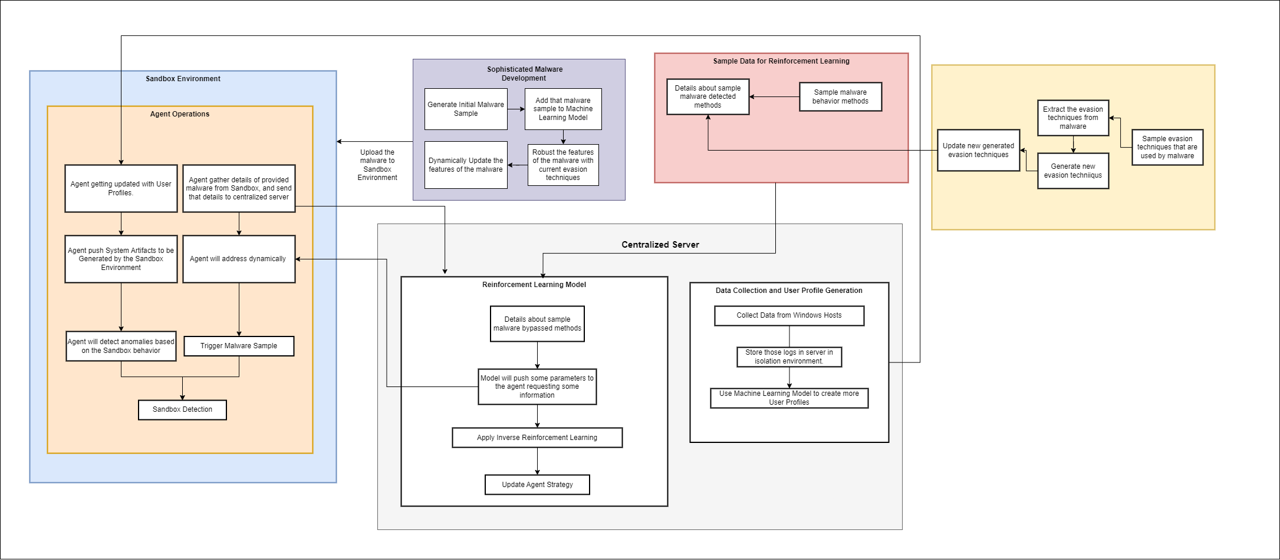
Overall System Diagram

Slide 4

IT21261046 | W.M.M.S.D.S. Perera
Cyber Security
IT21261046 | W.M.M.S.D.S. Perera | 24-25J-025

Slide 5
Research Gap
Research Problem
There is a lack of comprehensive studies focused on developing malware that can bypass advanced sandbox environments (like Cuckoo), especially using reinforcement learning (RL).
The specific issue is how to develop malware that can effectively evade detection by the
Cuckoo sandbox, utilizing RL to enhance the evasion capabilities dynamically.
Majority of this research, based on the defensive approach or proactive approach. But the offensive approach is also much needed for the take a good idea
about whole research area/domain.
IT21261046 | Perera WMMSDS | 24-25j-025

Slide 6
Sub Goals that Achieved from PP1
Add Evasion Sequences directly into Malware code.
Developed complex action table and relevant rewarding mechanisms to the RL Model.
Develop Custom Environment for the RL Agent and train the RL model.
Modified the sample Malware (Trojan) Evasion Techniques, so that it increase the Malware Evasion with the cuckoo sandbox by from 0-0.2 (in PP1) to 3.4 to 5.8 (full evasion)
From partially (in PP1) to fully (now) automating whole training process with the infrastructure.
IT21261046 | Perera WMMSDS | 24-25j-025

Slide 7
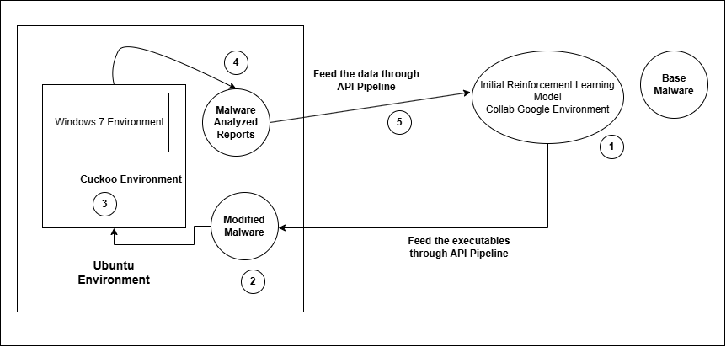
High-Level Infrastructure Overview
IT21261046 | Perera WMMSDS | 24-25j-025

Slide 8
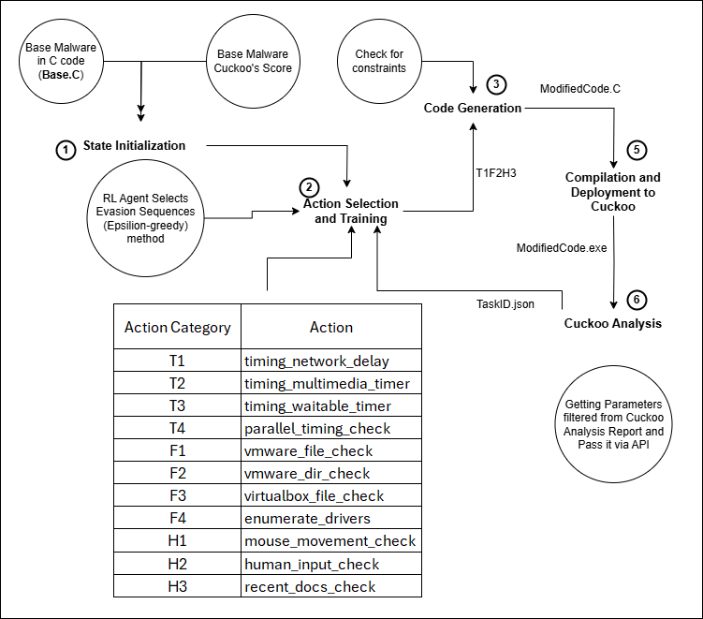
Work-Flow Setup
IT21261046 | Perera WMMSDS | 24-25j-025

Slide 9
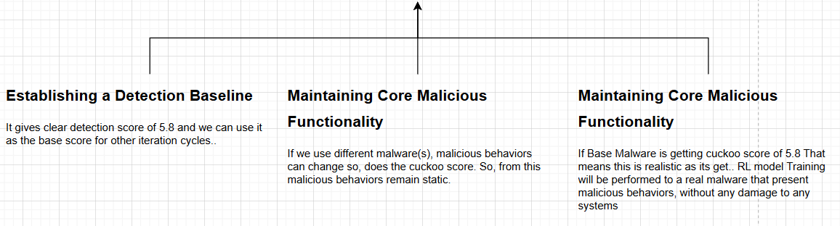
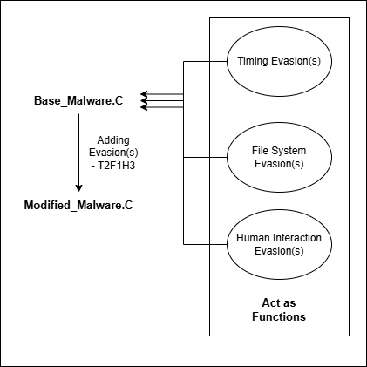
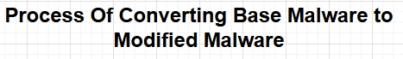
Why use a Base Malware as starting point?
IT21261046 | Perera WMMSDS | 24-25j-025

Slide 10
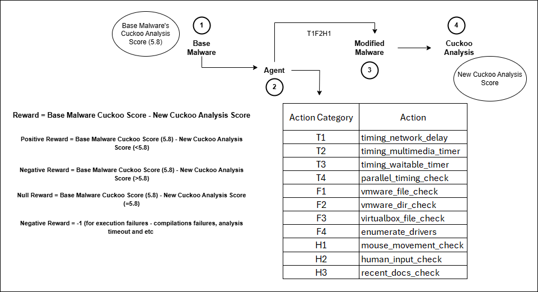
RL Model’s Action Table and Reward Assignment
IT21261046 | Perera WMMSDS | 24-25j-025

Slide 11
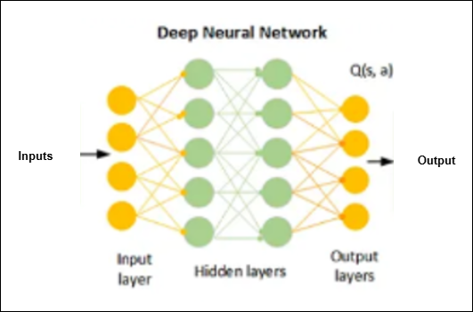
RL Model’s State Population
Input Layer: Inputs are base malware cuckoo detection score and binary indicators which evasion techniques have been applied.
Hidden Layers: There are two hidden layers (neurons) with each of 24 neurons. Use ReLU activation function to introduce non-linearity
Output Layer: Output values is consists of Q(s,a) values. The action with highest Q-value is selected during exploitation.
Information flow: Information or the knowledge stored as weight and each connection have different kind of weight assigned from the training process.
IT21261046 | Perera WMMSDS | 24-25j-025

Slide 12
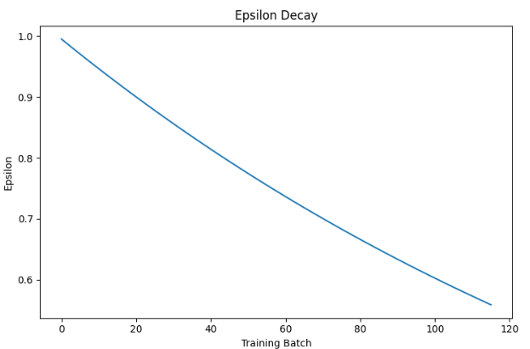
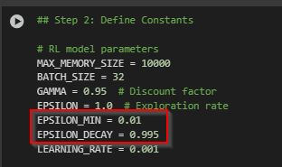
RL Model’s Exploration and Exploitation Phase
Exploration – When agent randomly selects evasion techniques regardless of past performance regardless of past experience
Exploitation - When agent selects evasion techniques that have previously shown good results.
Initially all actions are random (Epsilon rate 100%). This ensures exploration of the action space at the beginning. From each batch exploration decreases at E * 0.995 rate. This will provide gradual transition from exploration to exploitation
IT21261046 | Perera WMMSDS | 24-25j-025

Slide 13
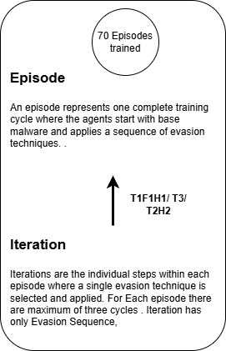
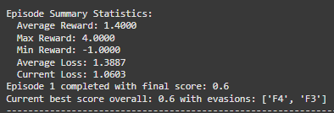
RL Model Training by each Episode
Episode one had two successful iterations which was 0.6 with both F4 and F3 Evasion sequences. Other Iteration has failed due to Compilation Error since the minimum reward is -1.00
IT21261046 | Perera WMMSDS | 24-25j-025

Slide 14
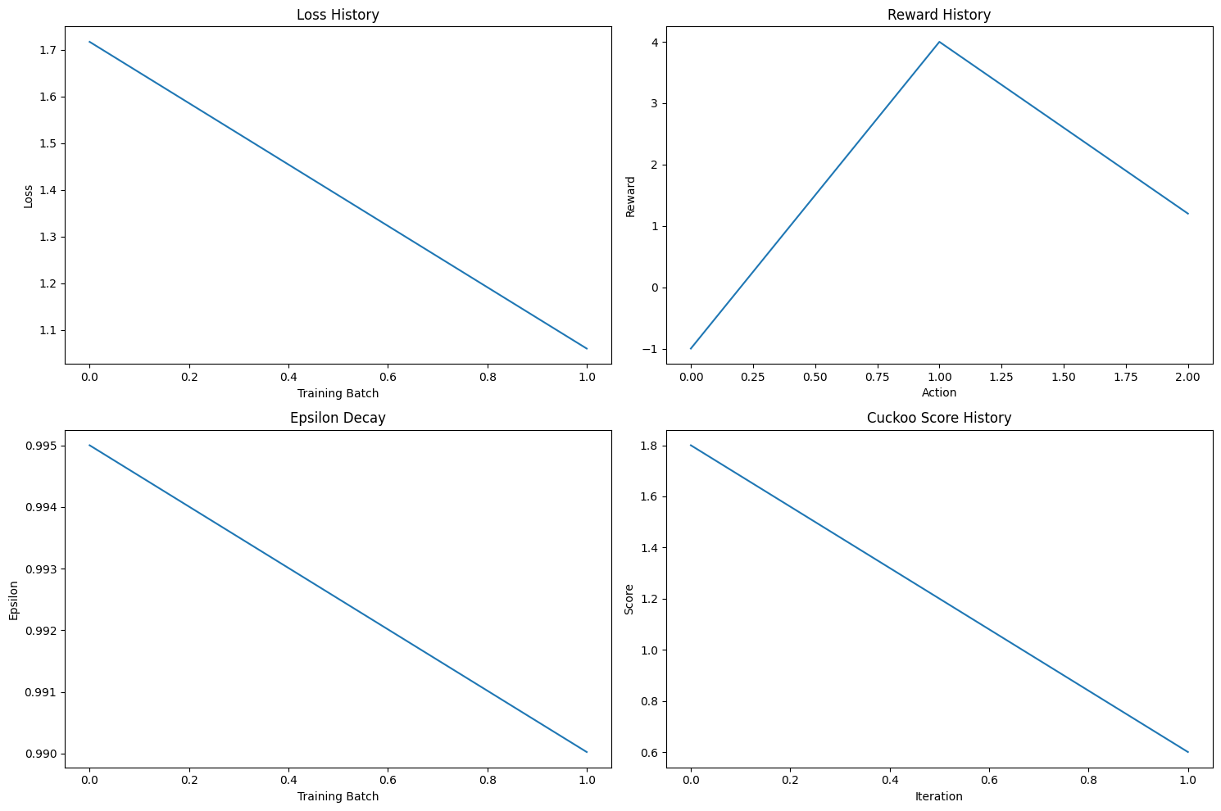
Cont. (For Each Episode Total Reward Figures)
IT21261046 | Perera WMMSDS | 24-25j-025

Slide 15
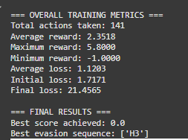
Final Results after Full Training Cycle (After 70 Episodes)
Total 70 Episodes training and 141 iterations. Full Evasion is achieved using H3 Evasion Sequence. Minimum Reward is -1 since it was the compilation error.
IT21261046 | Perera WMMSDS | 24-25j-025

Slide 16
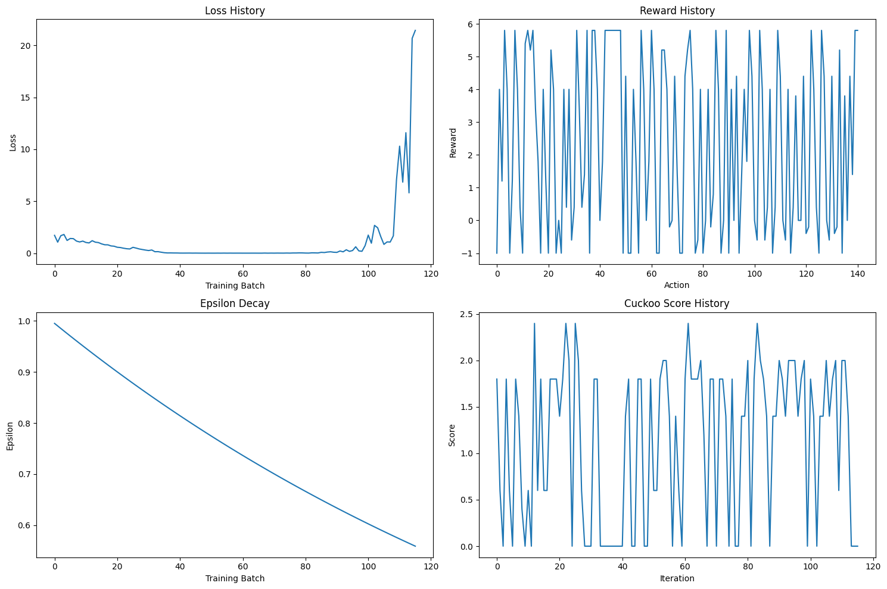
Cont. Final Results after Full Training Cycle (After 70 Episodes)
IT21261046 | Perera WMMSDS | 24-25j-025

Slide 17
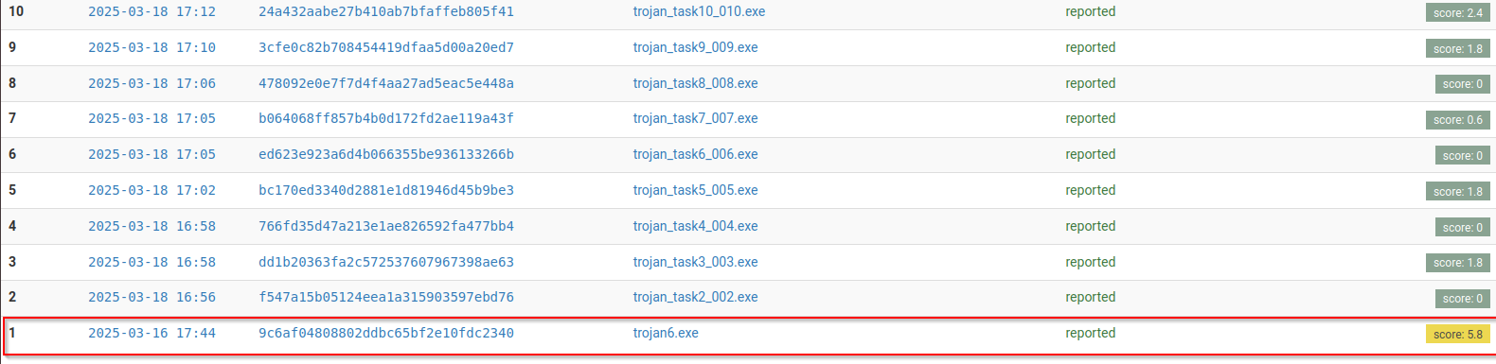
Modified Malware Cuckoo Evasion (Successful Examples)
IT21261046 | Perera WMMSDS | 24-25j-025

Slide 18
Next Step
Add more Evasion Categories and Evasions to Action Table. Then train with those evasions.
Connecting this RL Model output to other Research Components.
Train with another category of Malware (Ransomware).
IT21261046 | Perera WMMSDS | 24-25j-025

Slide 19
References
MERLIN- Malware Evasion with Reinforcement LearnINg (Ember and Malconv)
IT21261046 | Perera WMMSDS | 24-25j-025

Slide 20

IT21261664 | dias m.a.s.s.a
Cyber Security
IT21261664 | Dias M.A.S.S.A | 24-25J-025

Slide 21
Realistic User Behaviour Simulation to Counter Sandbox-Evasive Malware
How can realistic user behavior profiles with dynamic behaviour be generated, to enhance the user behaviour within the sandbox environment ?
IT21261664 | Dias M.A.S.S.A | 24-25J-025

Slide 22


Research Gap – From Lit Review
Research Paper | User Behaviour Simulation | Dynamic Data Utilization | Generative Model Usage | Realism of Simulated Behaviour
Enhancing malware analysis sandboxes with emulated user behavior (2022)
User behavior simulation with large language model based agents(2023)
Investigating anti-evasion malware triggers using automated sandbox reconfiguration techniques (2020)
Proposed Approach
IT21261664 | Dias M.A.S.S.A | 24-25J-025

Slide 23
Sub Goals Achieved
Defined the schema for initial user profile
Trained a GAN model to generate user profiles
Added dynamic browser related user interests to the user profile
Created the complete user profile with user behaviour characteristics
IT21261664 | Dias M.A.S.S.A | 24-25J-025

Slide 24
Sub Goals Achieved
Developed Scripting Engine to extract user profile attributes and generate scripts.
Developed module to schedule user behaviour simulations within the sandbox.
IT21261664 | Dias M.A.S.S.A | 24-25J-025

Slide 25
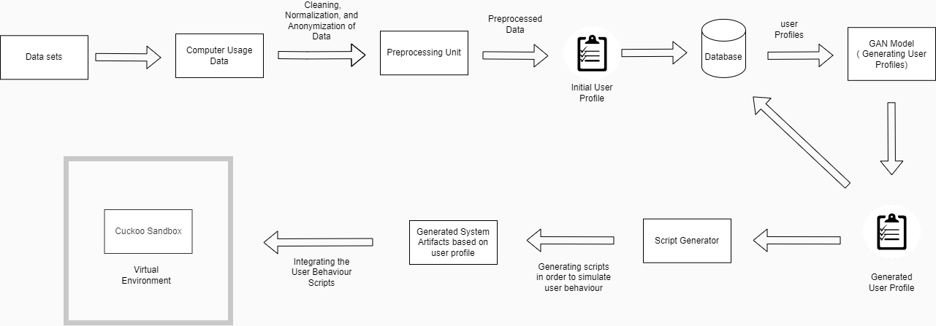
Methodology
IT21261664 | Dias M.A.S.S.A | 24-25J-025

Slide 26
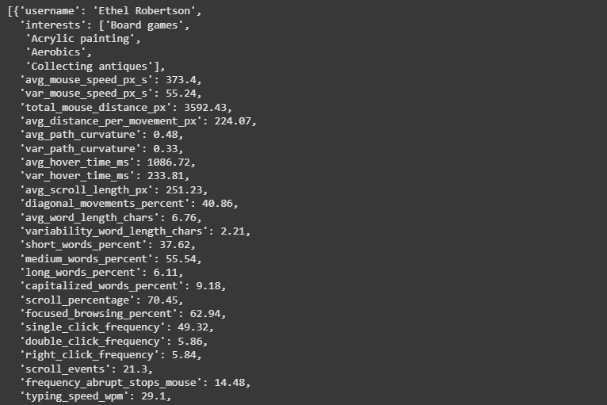
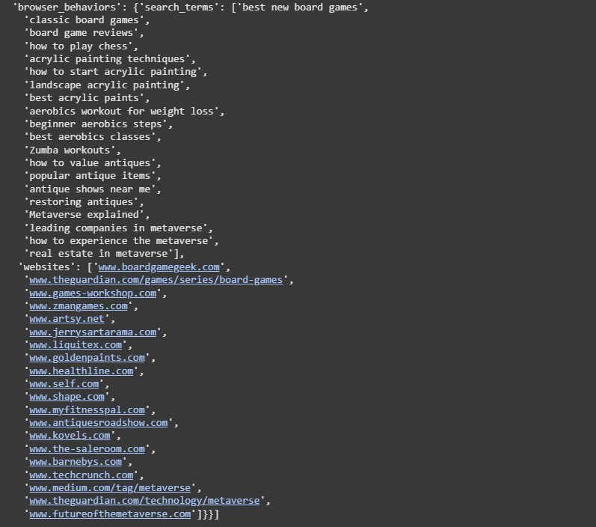
Completed User Profile
IT21261664 | Dias M.A.S.S.A | 24-25J-025

Slide 27
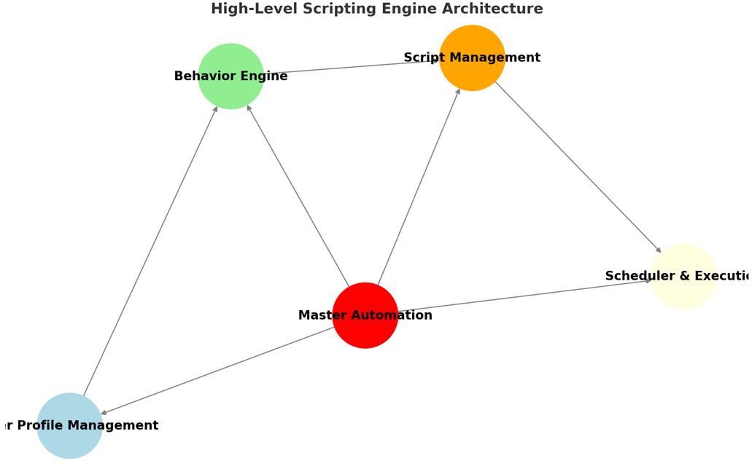
Scripting Engine
Automates the creation and execution of scripts to simulate realistic user behaviour within the sandbox environment.
IT21261664 | Dias M.A.S.S.A | 24-25J-025

Slide 28
Scripting Engine Workflow
Extracts User Profile Attributes
Updates Scripts Dynamically
Generates a Simulation Schedule
Automates Execution in Sandbox
IT21261664 | Dias M.A.S.S.A | 24-25J-025

Slide 29
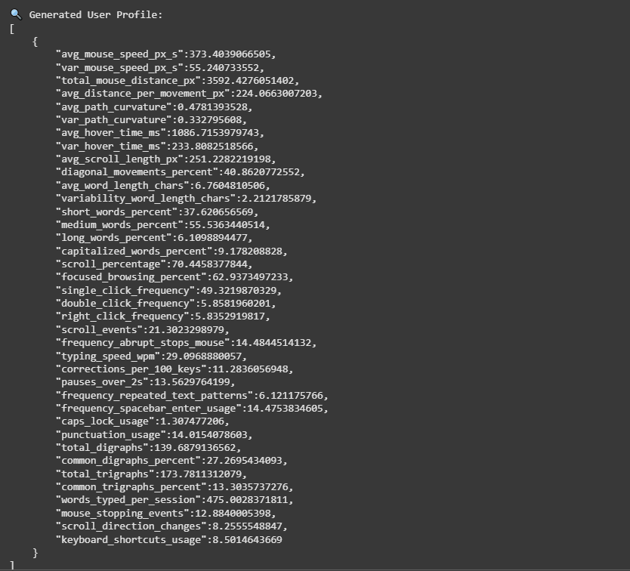
GAN Model Training
Model Architecture
Generator: 4-layer Fully Connected (LeakyReLU, Tanh Output)
Discriminator: 4-layer Fully Connected (Dropout 0.3, Sigmoid Output)
Training Setup
Latent Dimension: 100
Batch Size: 64
Epochs Trained: 1800
Optimizers: Adam (G: 0.0002, D: 0.0001)
IT21261664 | Dias M.A.S.S.A | 24-25J-025

Slide 30
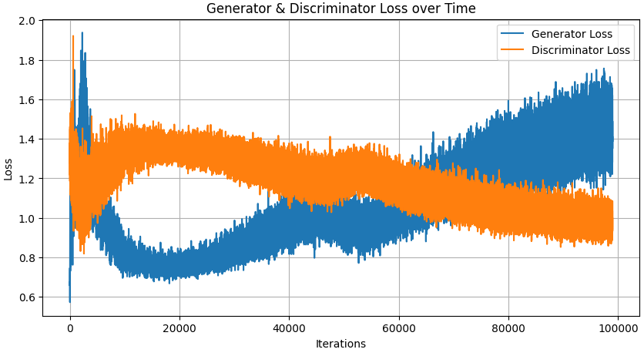
Generator & Discriminator Loss
IT21261664 | Dias M.A.S.S.A | 24-25J-025

Slide 31
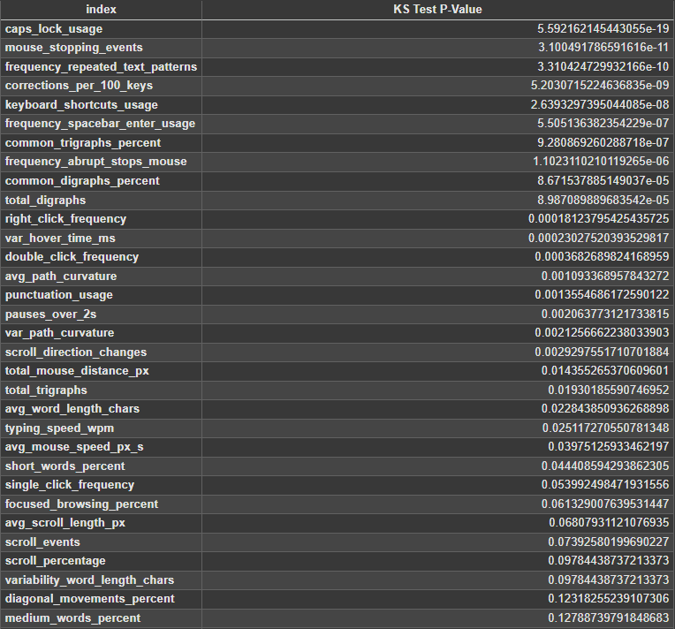
Kolmogorov-Smirnov (KS) Test
IT21261664 | Dias M.A.S.S.A | 24-25J-025

Slide 32
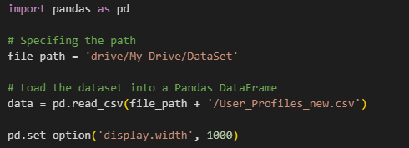
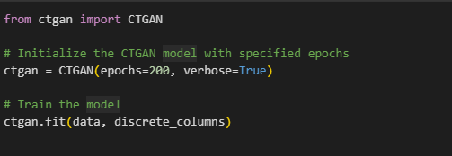
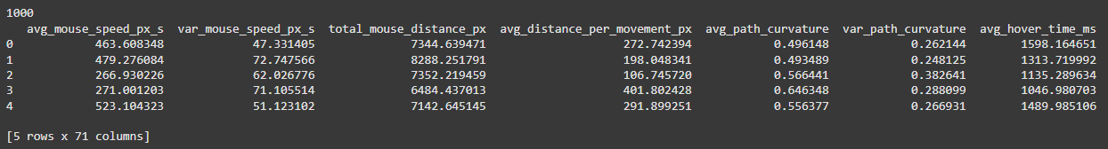
CTGAN Model Training
IT21261664 | Dias M.A.S.S.A | 24-25J-025

Slide 33
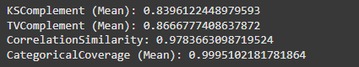
Evaluating the Generated Data
KSComplement (Mean) : - Similarity of continuous distributions.
TVComplement (Mean) : - Similarity of categorical distributions.
CorrelationSimilarity :- Similarity of pairwise correlations.
CategoricalCoverage (Mean) :- Shows generated data includes all the categories in the real data.
IT21261664 | Dias M.A.S.S.A | 24-25J-025

Slide 34
Next Steps
Fully automate the user behaviour simulation.
Implement more user behaviour activities.
IT21261664 | Dias M.A.S.S.A | 24-25J-025

Slide 35
References
[1] S. Liu, P. Feng, S. Wang, K. Sun, and J. Cao, “Enhancing malware analysis sandboxes with emulated user behavior,” Comput. Secur., vol. 115, no. 102613, p. 102613, 2022.
[2] C. Xie et al., “EnvFaker: A method to reinforce Linux sandbox based on tracer, filter and emulator against environmental-sensitive malware,” in _2021 IEEE 20th International Conference on Trust, Security and Privacy in Computing and Communications (TrustCom), 2021.
[3] L. Wang et al., “User behavior simulation with large language model based agents,” arXiv [cs.IR], 2023.
[4] A. Dunmore, J. Jang-Jaccard, F. Sabrina, and J. Kwak, “Generative Adversarial Networks for malware detection: A survey,” arXiv [cs.CR], 2023.
[5] A. Mills and P. Legg, “Investigating anti-evasion malware triggers using automated sandbox reconfiguration techniques,” J. Cybersecur. Priv., vol. 1, no. 1, pp. 19–39, 2020.
IT21261664 | Dias M.A.S.S.A | 24-25J-025

Slide 36

IT21299452 | Dilhara W. M. A.
Cyber Security
IT21299452 | Dilhara W. M. A. | 24-25J-025

Slide 37
Developing an LSTM-based Model to Detect Sandbox Evasion Techniques Used by Malware
malware developers do not want their malware to be analyzed in isolated environments. Therefore, they design their code to detect virtual machine and sandbox environments and avoid executing malicious behavior while running in these isolated environments.
Agent Tesla remote access trojan (RAT) shuts down if it detects a sandbox environment as an example of malware sandbox evasion [1].
Malware authors are no stranger to code-reuse and cut&paste approaches[2].
IT21299452 | Dilhara W. M. A. | 24-25J-025
Notes:
My component focusing on "Developing a Generative Model to Analyze and Detect Sandbox Evasion Techniques Employed by Malware." This project represents an intersection of cybersecurity and machine learning, where we aim to enhance malware detection methods.
Malware developers are increasingly designing their malicious software to detect when it's running in a sandbox or virtual machine environment—places where we typically analyze malware. This detection allows them to avoid executing their malicious payload, which makes traditional analysis methods less effective.
For example, the Agent Tesla remote access trojan (RAT) is known to shut down if it detects a sandbox environment. Such evasion techniques pose a significant challenge to cybersecurity professionals who rely on sandboxing as a key defense mechanism.
Also most of those who create malware frequently use existing pieces of code from other malware or sources rather than writing new code from scratch
So In this project, I aim to address this challenge of sandbox evasion and advantage of code reuse
"Good [morning/afternoon], everyone. My name is [Your Name], and I’m excited to present my project titled ‘Proactive Detection and Generation of Sandbox Evasion Techniques Using Generative Models.’This project addresses a critical gap in cybersecurity by focusing on identifying and simulating evasion techniques used by malware to bypass sandbox detection systems."

Slide 38
Research Question
Primary issue - Existing sandbox evasion detection systems heavily rely on historical patterns and known API call signatures, failing to adapt to novel or rare evasion techniques that deviate from established rules.
Problem Statement: How can a LTSM model be utilized to predict sandbox evasion techniques employed by malware ?
Existing challenges:
Limited datasets of evasion behaviours.
IT21299452 | Dilhara W. M. A. | 24-25J-025
Notes:
Given this context, the core question driving my research is: "How can a VAE-based generative model be utilized to both detect and generate sandbox evasion techniques employed by malware?”
This question underpins the innovative approach of my project, focusing on not just detection but also the proactive generation of potential evasion strategies.
"The primary focus of this research is to understand how malware employs sandbox evasion techniques and how we can proactively detect these behaviors. The question I aim to answer is: How can we leverage a generative model like a Variational Autoencoder to not only detect but also simulate new sandbox evasion techniques?"This project bridges the gap between reactive malware detection and proactive evasion technique identification."

Slide 39


Research Gap
Research | Analyze & Detect Malware evasion techniques | Integrate with a sandbox for analyze | Comparative detection
M. Ficco, "Malware Analysis by Combining Multiple Detectors and Observation Windows," June 2022 [3].
"Comparative Study of Detection and Analysis of Different Malware with the Help of Different Algorithm,2023”[4].
"On the Effectiveness of Perturbations in Generating Evasive Malware Variants, 2023”[5].
Proposed Approach
IT21299452 | Dilhara W. M. A. | 24-25J-025
Notes:
Most existing systems focus on identifying known evasion techniques only after they've been deployed in the wild. This leaves a significant gap on malware detection
As the draft shows some of these recent research are able to detect malware evasion but not in a proactive manner ,
Some are analyzing without integrating with a sandbox so their analyses are heavly limited in a dyanamic level
And our proposed approach will brige those gaps by covering all these areas
"Most existing malware detection systems rely on known patterns of malicious behavior. However, malware authors are constantly innovating, creating techniques to evade these systems. Current models struggle with new or unknown evasion behaviors, leaving a critical gap in detection strategies.""This project addresses that gap by using a VAE model, which learns from patterns in API sequences and generates new, potential evasion techniques to proactively improve sandbox detection systems."

Slide 40
Specific and Sub Objectives
Specific Objective
Develop a LSTM model to analyze and detect sandbox evasion techniques employed by malware and predict potential evasion strategies.
Sub Objectives
Data Collection and Preprocessing
Gather and preprocess a comprehensive dataset of malware API call sequences labeled with evasion techniques.
Synthetic Data Generation
Goal: Balance underrepresented evasion classes using rule-guided synthetic API sequences.
Model Development
Goal: Design a multi-label bidirectional LSTM for evasion detection. And the rule based further analysis
IT21299452 | Dilhara W. M. A. | 24-25J-025
Notes:
To tackle this challenge, I’ve outlined several sub objectives based on the main:
Synthetic Data Generation
Goal: Balance underrepresented evasion classes using rule-guided synthetic API sequences.
Actions:
Use rule-based generation (not GANs, as per the provided code) to create synthetic sequences.
Inject high-confidence evasion APIs (e.g., NtQuerySystemInformation) with common APIs for realism.
Validate synthetic sequences against detection thresholds (e.g., min_unique_apis).
Model Development
Goal: Design a multi-label bidirectional LSTM for evasion detection.
Actions:
Detection: Train the LSTM to classify API sequences into evasion categories using sigmoidactivation.
Sequential Learning: Leverage bidirectional layers to capture contextual API relationships.
Regularization: Integrate dropout layers to prevent overfitting.

Slide 41
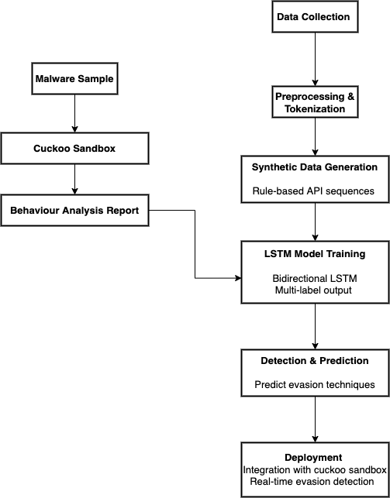
System Diagram
IT21299452 | Dilhara W. M. A. | 24-25J-025
Notes:
Key Flow Explanation:
Data Collection: Raw malware samples and sandbox reports (Cuckoo) are gathered.
Preprocessing: APIs are tokenized, padded, and structured for model input.
Synthetic Data: Rule-based sequences augment rare evasion classes.
LSTM Training: Model learns patterns from hybrid (real + synthetic) data.
Detection: Predicts evasion techniques from API sequences.
Evaluation: Measures performance and refines thresholds/model.
Deployment: Integrates into sandbox environments for live analysis.

Slide 42
Current Progress
Implemented Synthetic API Sequence Generation
Built and Trained a Bidirectional LSTM Model
Integrated Cuckoo Sandbox Report Parsing
Notes:
Here’s an overview of my progress so far. I’ve completed sandbox report parsing to extract API sequences and trained a

Slide 43
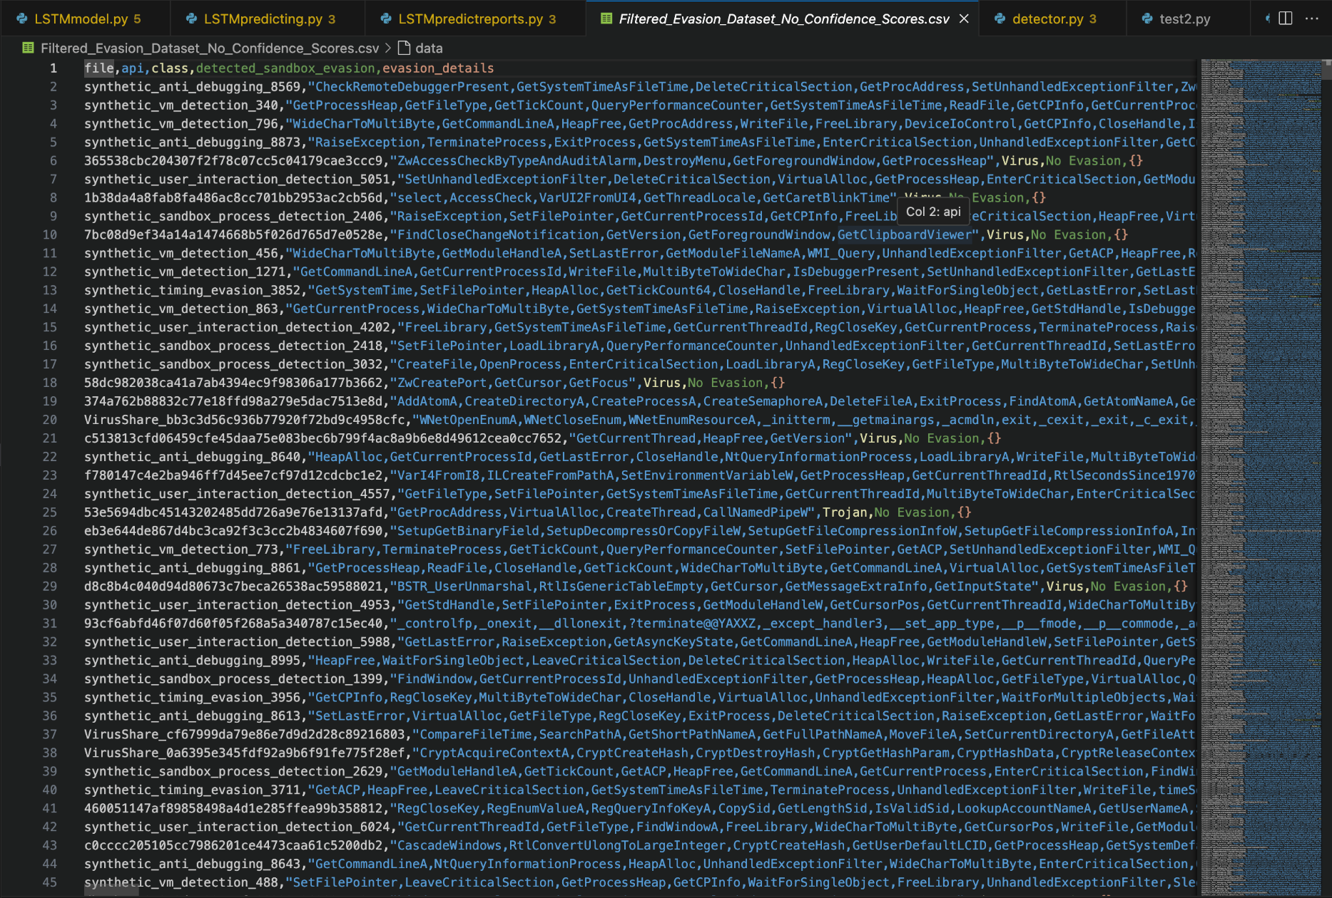
Data Collection
Notes:
"The dataset used for this project primarily consists of API sequences extracted from sandbox reports. These sequences represent system-level behavior, making them an ideal feature for detecting anomalies.""The evasion dataset I created links specific API sequences to known evasion techniques. This dataset is used in the rule-based system to identify evasion methods."

Slide 44
Synthetic Data Generation
Rule-Based Sequence Creation: Generates synthetic API sequences using predefined rules, combining high-confidence evasion APIs with common APIs for realism.
Threshold Validation: Ensures synthetic sequences meet detection criteria.
Dataset Balancing: Augments underrepresented evasion classes to improve model performance on rare techniques.

Slide 45
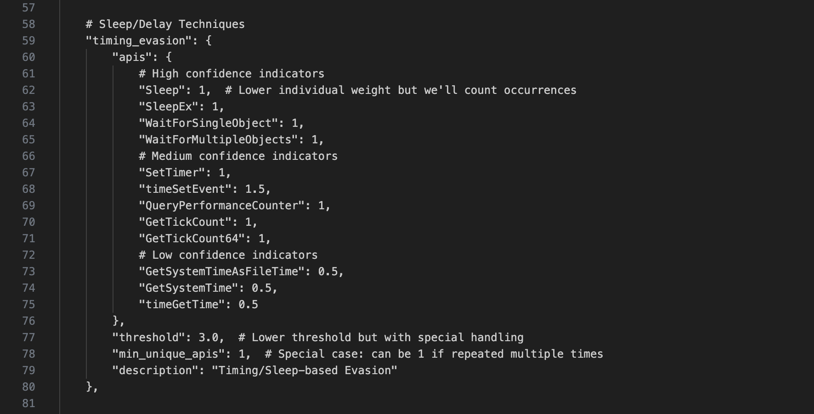

Slide 46
Why Only API Sequences
The dataset primarily holds API sequences, making them the central feature for analysis.
API calls are a direct representation of system-level behaviors, which are critical for identifying sandbox evasion techniques.
Unlike network/registry data, API sequences focus purely on execution flow, reducing false positives.

Slide 47
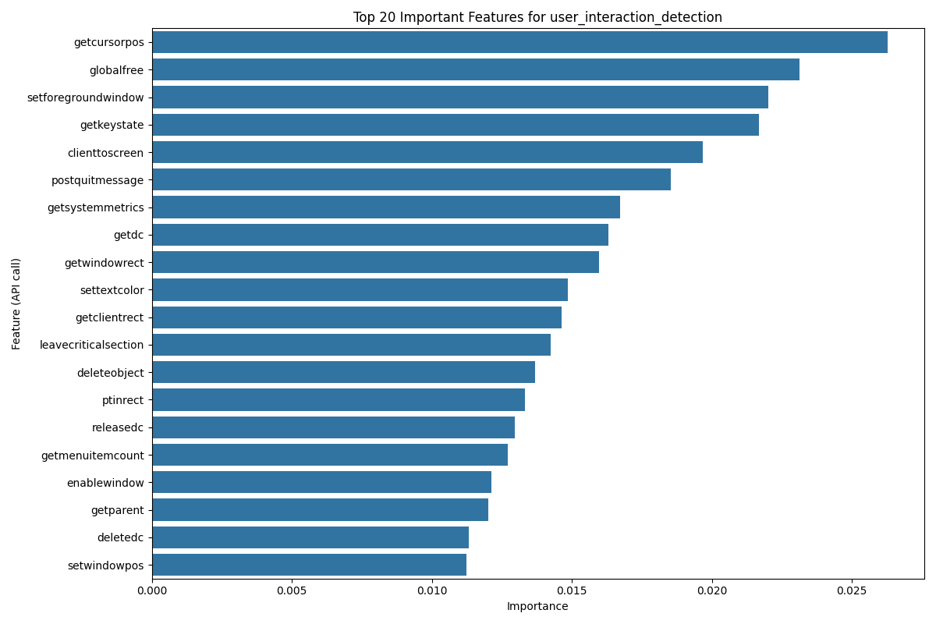
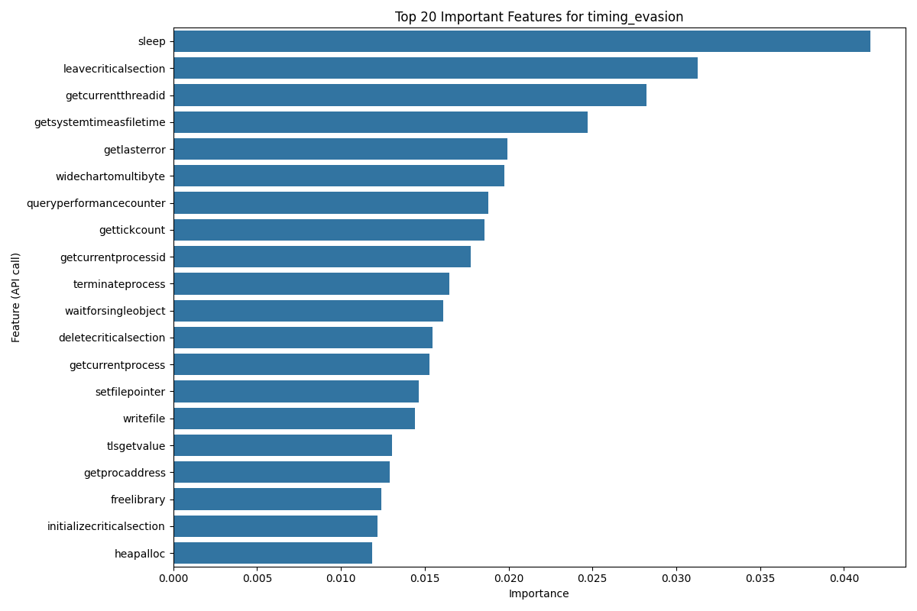
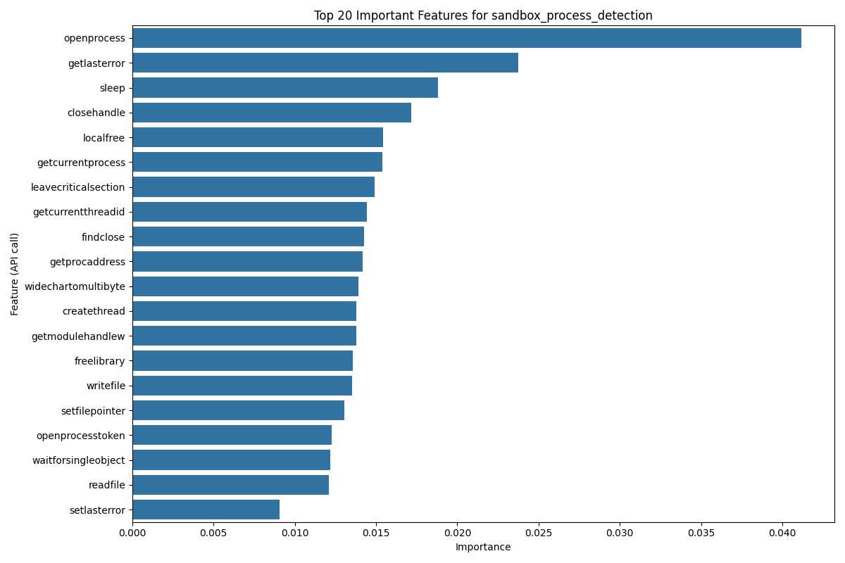
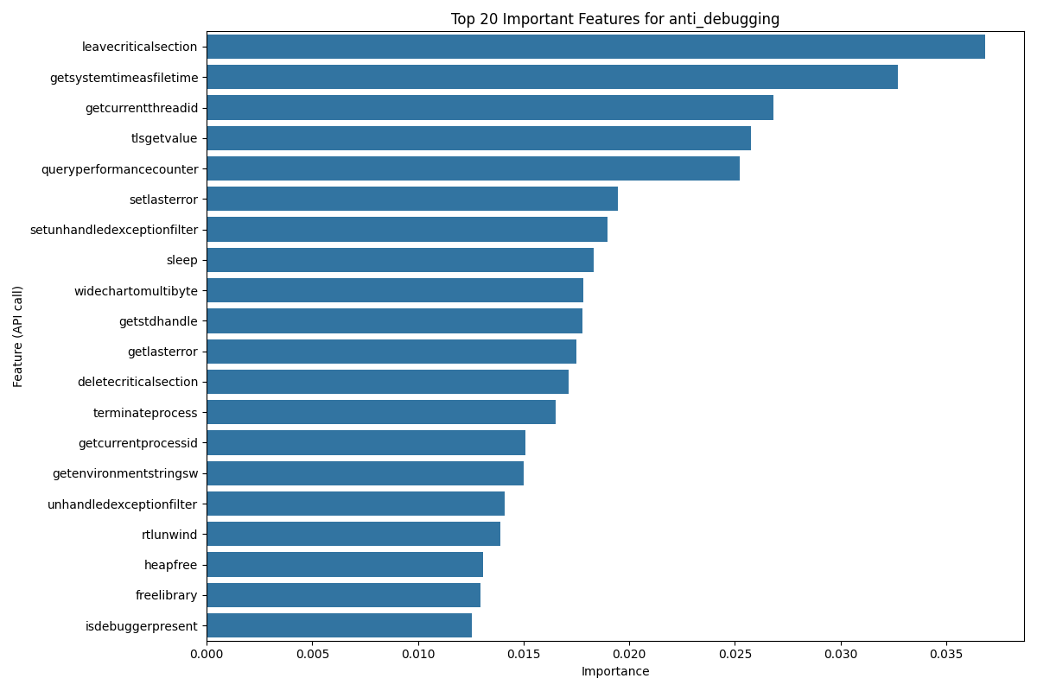

Slide 48
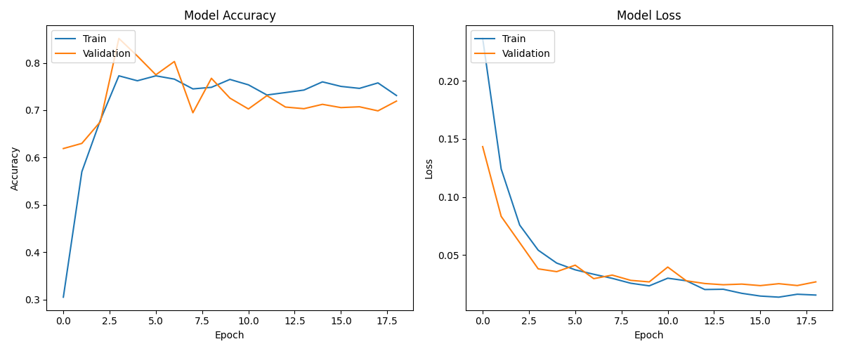
LSTM Model Development
Bidirectional LSTM: Captures contextual relationships in API sequences (past + future dependencies).
Multi-Label Output: Sigmoid activation for detecting multiple evasion techniques simultaneously.
Notes:
"My model uses a Bidirectional LSTM, which captures contextual relationships in API sequences by analyzing both past and future dependencies. Additionally, it uses a multi-label classification approach with a Sigmoid activation function to detect multiple evasion techniques simultaneously."

Slide 49
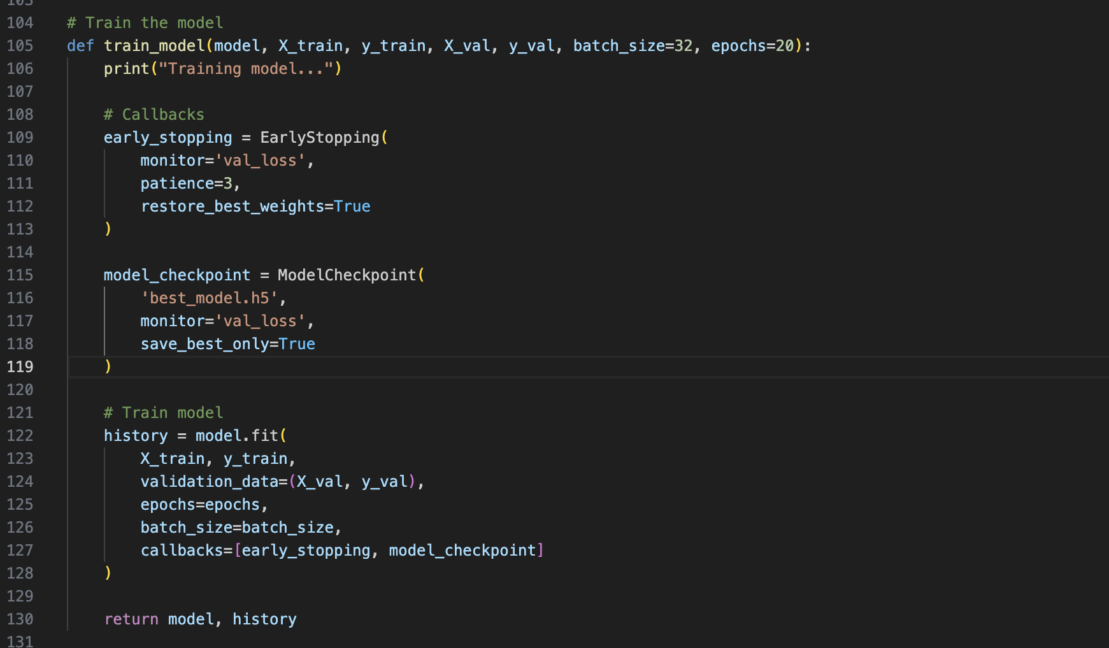
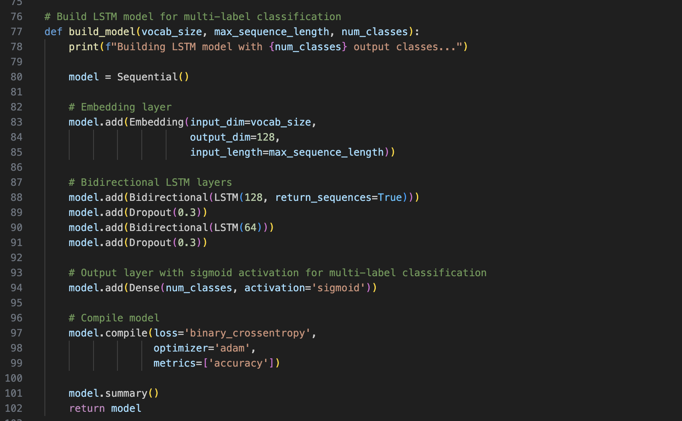
Notes:
Initializes a sequential model, which is a linear stack of layers. Simplifies the process of adding layers one after another.
Converts integer-encoded API sequences (tokens) into dense vectors of fixed size (128 dimensions). output_dim: Dimension of the dense embedding (128).
Adds a bidirectional LSTM layer with 128 units
dds a dropout layer with a 30% dropout rate to prevent overfitting.
Uses sigmoid activation to produce probabilities for each class. sigmoid is ideal for multi-label classification, where each class is independent.
Train_model
Stops training if the validation loss does not improve for 3 consecutive epochs (patience=3).

Slide 50
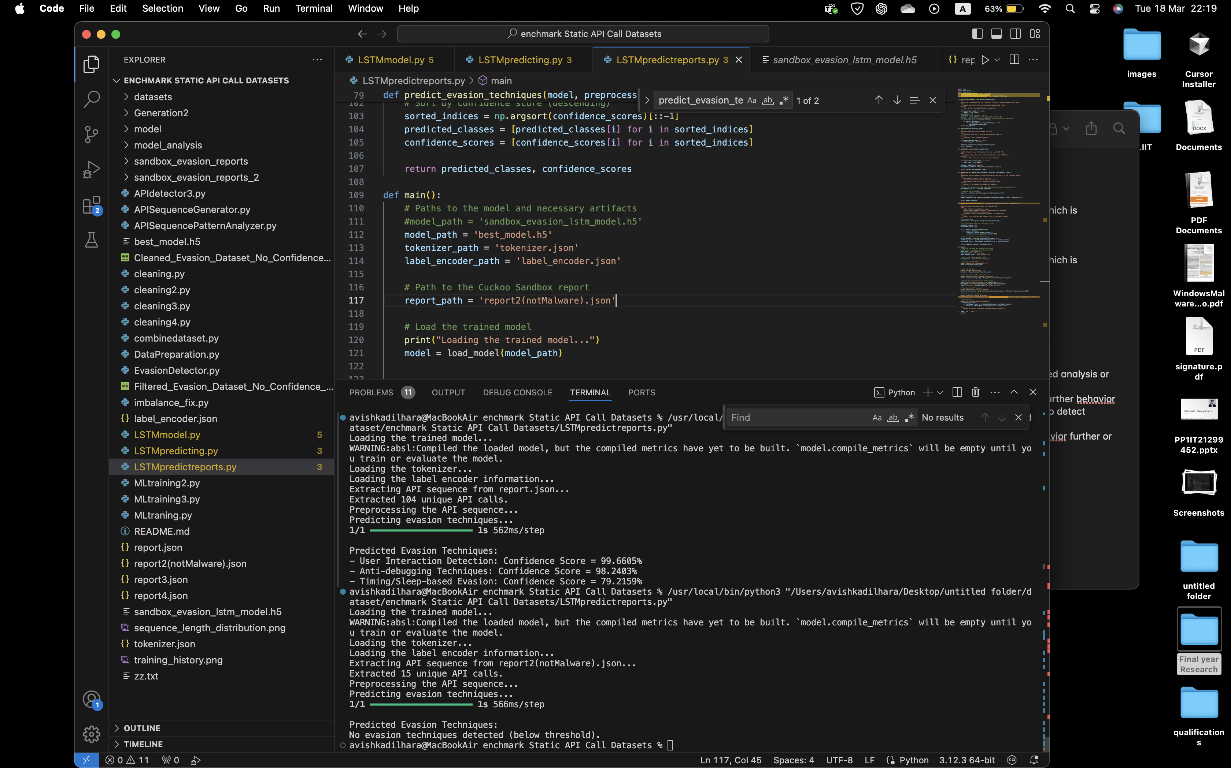
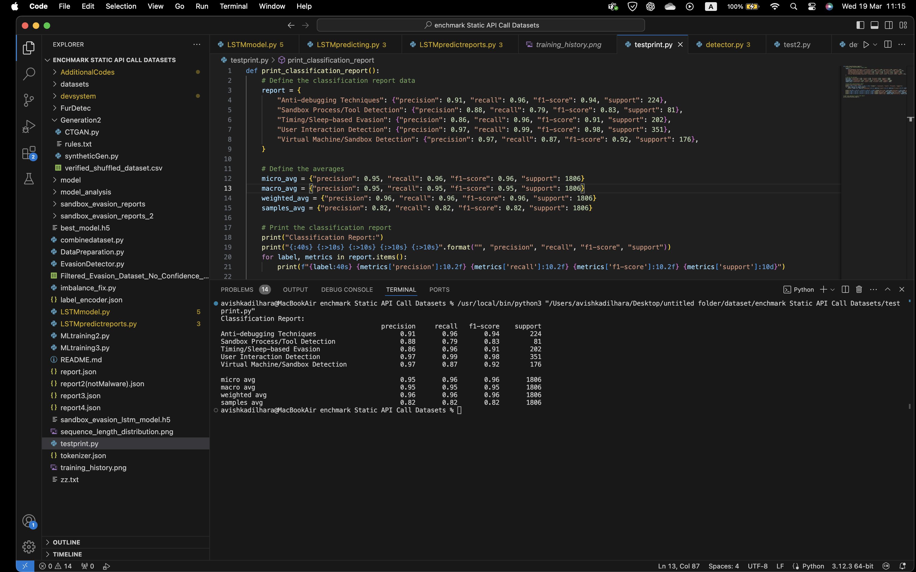
Example Workflow Execution
Notes:
This slide shows an example of how my model processes input API call sequences and classifies them into different evasion techniques. The LSTM model predicts whether a given sequence shows any sandbox evasion behavior."

Slide 51
Future Work
Expand synthetic data rules to cover edge-case evasion patterns (e.g., API permutations, indirect checks).
Integrate the model into live sandbox environments for real-time analysis during malware execution.
Develop a feedback loop for continuous model improvement using live sandbox data.
IT21299452 | Dilhara W. M. A. | 24-25J-025
Notes:
"Moving forward, my next steps include:
Expand Synthetic Data Rules:
Add edge-case evasion patterns (e.g., API call permutations, indirect checks) to cover advanced malware tactics.
Ensure synthetic sequences mimic real-world adversarial behavior more closely.
Real-Time Sandbox Integration:
Embed the LSTM model into live sandbox environments for on-the-fly evasion detection.
Enable real-time API sequence analysis during malware execution, reducing post-analysis delays.
Dynamic Thresholding:
Use reinforcement learning to optimize detection thresholds per evasion technique.
Improve confidence scoring by considering API sequence context (e.g., order, frequency).

Slide 52
References
[1] S. Gallagher and M. Picado, “Agent Tesla amps up information stealing attacks,” 02Feb2021.https://news.sophos.com/enus/2021/02/02/agent-tesla-amps-up-informati on-stealing-attacks/.
[2] S. Gallagher and M. Picado, “Agent Tesla amps up information stealing attacks,” 02Feb2021.https://news.sophos.com/enus/2021/02/02/agent-tesla-amps-up-informati on-stealing-attacks/.
[3] M. Ficco, "Malware Analysis by Combining Multiple Detectors and Observation Windows," vol. 71, no. 6, pp. 1276-1290, 1 June 2022, doi: 10.1109/TC.2021.3082002.
[4] P. A. Selvaraj, M. Jagadeesan, T. M. Saravanan, A. Kumar, A. Kumar and M. K. Singh, "Comparative Study of Detection and Analysis of Different Malware with the Help of Different Algorithm," 2023 International Conference on Computer Communication and Informatics (ICCCI), Coimbatore, India, 2023, pp. 1-6, doi: 10.1109/ICCCI56745.2023.10128452.
[5] B. Jin, J. Choi, J. B. Hong and H. Kim, "On the Effectiveness of Perturbations in Generating Evasive Malware Variants," in IEEE Access, vol. 11, pp. 31062-31074, 2023, doi: 10.1109/ACCESS.2023.3262265.
IT21299452 | Dilhara W. M. A. | 24-25J-025
Notes:
Here are the references that have informed my research "This concludes my presentation. Thank you for your time.

Slide 53

IT21300950 | VITHANAGE V. K. M.
Cyber Security
IT21300950 | VITHANAGE V. K. M. | 24-25J-025

Slide 54
A Reinforcement Learning agent to dynamically modify the behaviour of a sandbox based on specific malware samples
Modern malware employ variuos evasion strategies to hide their behaviour when inside a sandbox environment
To detect malware in a sandbox environement, only reactive approaches have been applied
The need of proactive approaches similar to adaptive sandbox environment is present in the industry
IT21300950 | VITHANAGE V. K. M. | 24-25J-025

Slide 55
Research Question
How can sandbox environments be designed to dynamically modify their behaviour in response to the characteristics of specific malware samples with aid of an RL agent?
IT21300950 | VITHANAGE V. K. M. | 24-25J-025

Slide 56
Methodology of RL Agent
Upload malware to Cuckoo Sandbox
Retrieve the analyzed reports
Reupload same malware
Apply counter-evasion strategies
Allocate rewards or penalties
Repeat the process to train the agent
IT21300950 | VITHANAGE V. K. M. | 24-25J-025

Slide 57
Current Progress
Developed the custom enviornment to train the RL agent’s model
Created counter evasion strategies as actions for the RL agent
Conducted training of RL agent
IT21300950 | VITHANAGE V. K. M. | 24-25J-025

Slide 58
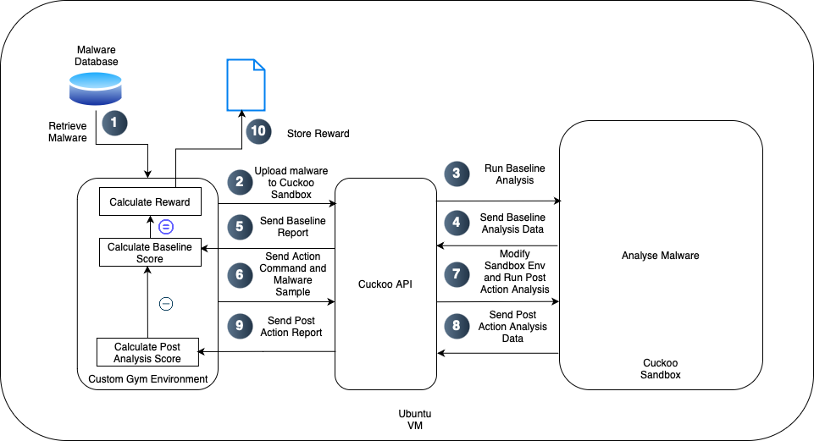
An automated script to analyze malware and report
IT21300950 | VITHANAGE V. K. M. | 24-25J-025

Slide 59
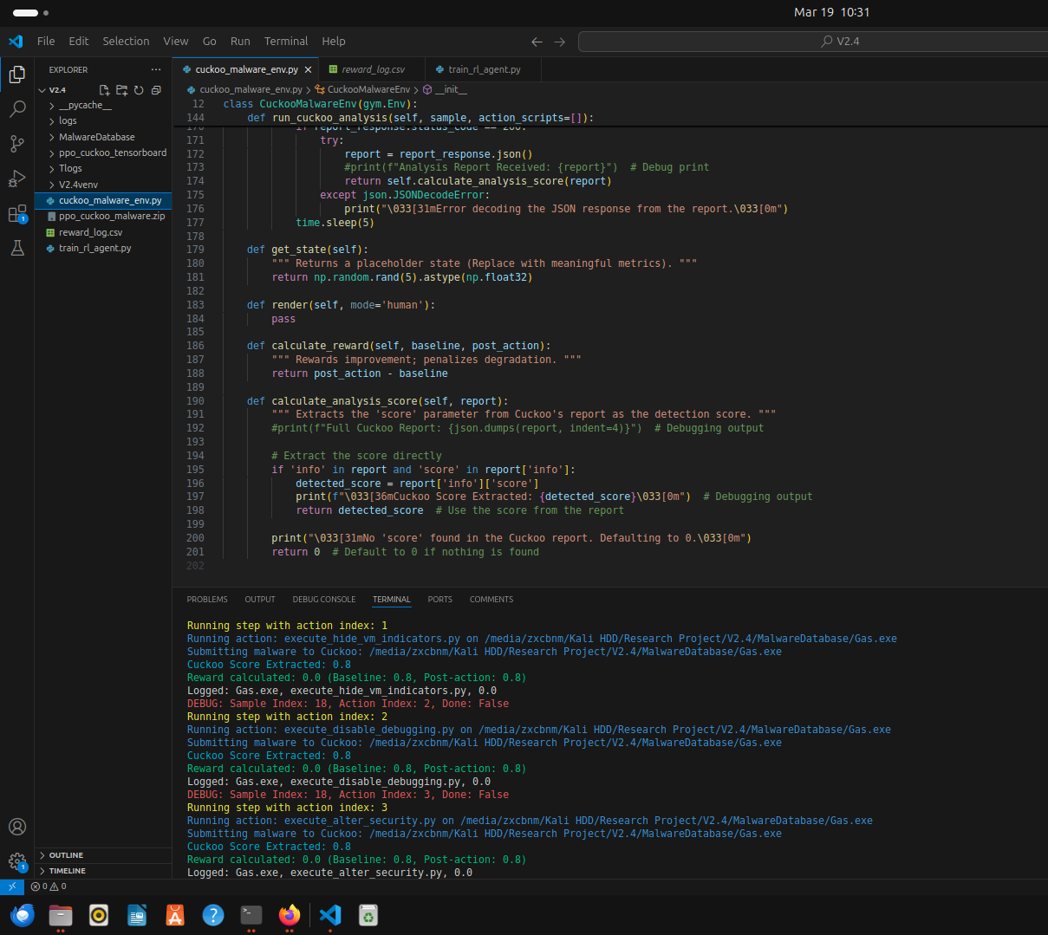
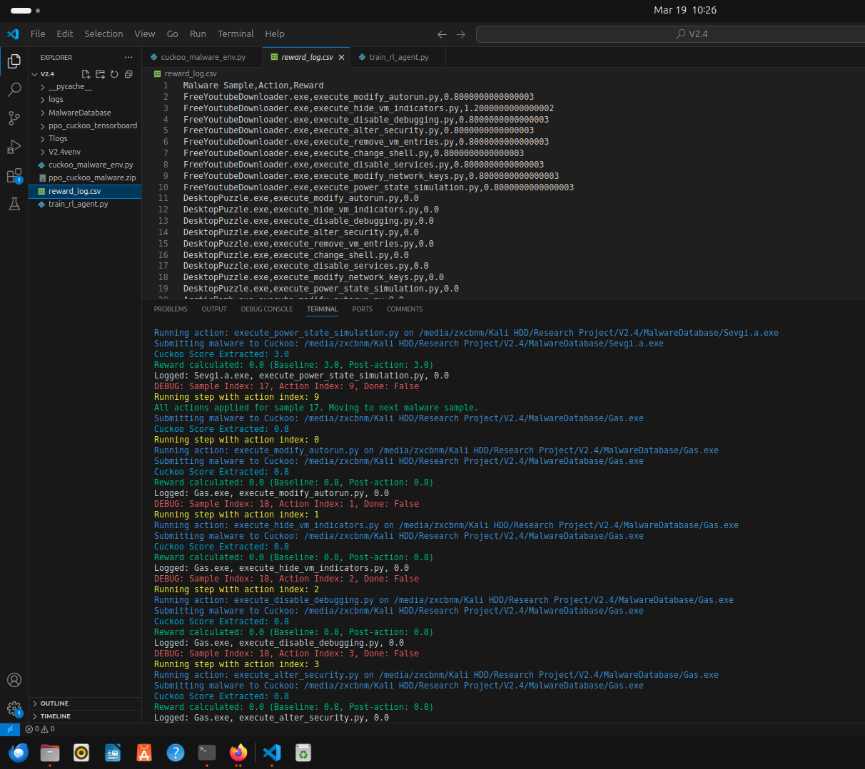
Reward Calculation
IT21300950 | VITHANAGE V. K. M. | 24-25J-025

Slide 60
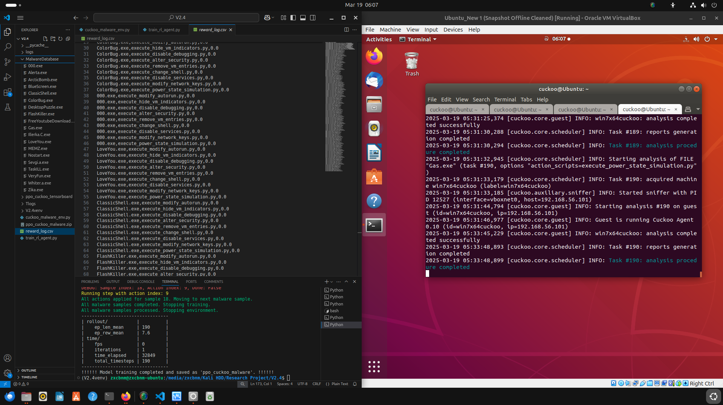
RL Agent Training Results
IT21300950 | VITHANAGE V. K. M. | 24-25J-025

Slide 61
Next Steps
Modify Counter Evasion Strategies to Maximize Rewards
Integrate group members’ componets
IT21300950 | VITHANAGE V. K. M. | 24-25J-025

Slide 62
Thank You!
24-25J-025

